Slide 1
RUNGTA COLLEGE OF DENTAL SCIENCES AND RESEARCH,BHILAI Abscesses of the periodontium
Dr pushpendra singh yadav
Sr Lecturer
Dept of Periodontology

Slide 2
SPECIFIC LEARNING OBJECTIVES
CORE AREAS | DOMAIN | CATEGORY
Classification | Cognitive | Desire to know
Etiology | Cognitive | Must to know
Pathogenesis and Histopathology | Cognitive | Must to know
Diagnosis Differential diagnosis | Cognitive Cognitive | Must to know Nice to know

Slide 3
CONTENT
Introduction
Classification
Gingival Abscess
Pericoronal Abscess
Periodontal Abscess
Etiology
Pathogenesis and Histopathology
Diagnosis
Differential Diagnosis
Summary
References

Slide 4
Introduction
The periodontal abscess has also been defined as a with an expressed periodontal breakdown, occurring during a limited period of time and with easily detectable clinical symptoms, with a localised accumulation of pus, located within the gingival wall of the periodontal pocket.

Slide 5
Classification
The 1999 International workshop for the classification of periodontal diseases organized by AAP has classified abscesses of the periodontium as
Gingival abscess
Periodontal abscess
Pericoronal abscess.

Slide 6
Gingival Abscess
A gingival abscess is defined as a localized purulent infection that involves the marginal gingiva or interdental papilla
Confined to ……only the gingival marginal tissues which are previously a nondiseased site.

Slide 7
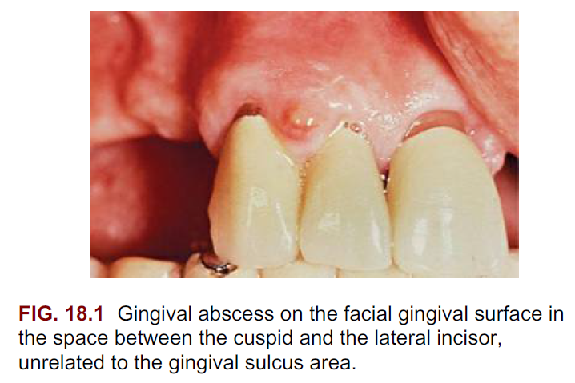
It is often an acute inflammatory response to the impaction of food material or a foreign body into the gingiva

Slide 8
In its early stages, it appears as a red swelling with a smooth, shiny surface.
Within 24–48 h, the lesion usually becomes fluctuant and pointed, with a surface orifice from which a purulent exudate may be expressed.
The adjacent teeth are often sensitive to percussion.
If permitted to progress, the lesion generally ruptures spontaneously

Slide 9
Histopathology
The gingival abscess consists of a purulent focus in the connective tissue surrounded by a diffuse infiltration of polymorphonuclear leukocytes, edematous tissue, and vascular engorgement.

Slide 10
The surface epithelium has varying degrees of intracellular and extracellular edema, invasion by leukocytes, and sometimes ulceration.

Slide 11
Etiology
Acute inflammatory gingival enlargement results from bacteria carried deep into the tissues when a foreign substance (e.g., toothbrush bristle, piece of apple core, lobster shell fragment) is forcefully embedded into the gingiva.

Slide 12
The lesion is confined to the gingiva and should not be confused with periodontal or lateral abscesses.

Slide 13
Pericoronal Abscess
The pericoronal abscess associated with the crown of a partially erupted tooth is one of the complications of pericoronitis.
It may spread posteriorly into the oropharyngeal areas and medially to the base of the tongue, making it difficult for the patient to swallow.

Slide 14
Periodontal (lateral) abscess
localized purulent inflammation in the periodontal tissues.
It is also known as a lateral abscess or a parietal abscess.
It is an infection located contiguous to the periodontal pocket and may result in destruction of the periodontal ligament and alveolar bone.

Slide 15
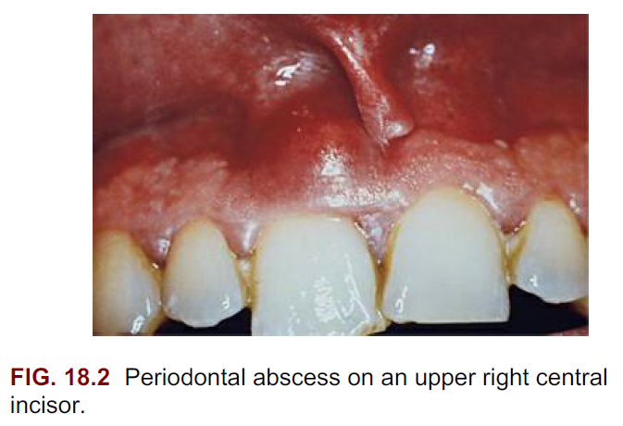

Slide 16
Classification of periodontal abscess
I. According to location
II. According to onset or course of lesion
III. Depending on number

Slide 17
I. According to location
Abscess in the supporting periodontal tissues along the lateral aspect of the root.
Abscess in the soft tissue wall of the deep periodontal pocket.

Slide 18
II. According to onset or course of lesion
1. Acute periodontal abscess:
It appears as a bright red ovoid
elevation of the gingiva, which may be relatively firm or
pointed and soft. In most instances, pus may be expressed
from the gingival margin by gentle digital pressure

Slide 19
It is accompanied by symptoms such as throbbing, radiating pain, sensitivity to percussion, tooth mobility, and, in some cases, lymphadenopathy and systemic effects such as fever and malaise.

Slide 20
2. Chronic periodontal abscess:
It usually presents a sinus that opens onto the gingival mucosa somewhere along the root length.
It is usually asymptomatic. However, the patient may complain of intermittent exudation, dull gnawing pain, slight elevation of the tooth, and a desire to bite down on and grind the tooth

Slide 21
Acute lesions often subside but persist in the chronic state, whereas chronic lesions may exist without being acute.
Chronic lesions frequently undergo acute exacerbation.

Slide 22
III. Depending on number
Single periodontal abscess:
They are usually related to local factors that contribute to the closure of the periodontal pocket.
2. Multiple periodontal abscess:
They have been reported in diabetes mellitus and medically compromised patients.

Slide 23
Signs and Symptoms of Periodontal Abscess
Acute abscess
Chronic abscess
Mild to severe discomfort
Localized red, ovoid swelling
Periodontal pocket
Mobility
Tooth elevation in socket
Tenderness to percussion or biting
Exudation
Elevated temperaturea
Regional lymphadenopathya
No pain or dull pain
Localized inflammatory lesion
Slight tooth elevation
Intermittent exudation
Fistulous tract often associated with a deep pocket
Usually without systemic involvement

Slide 24
Etiology
Periodontal abscesses have been associated either directly to periodontitis (periodontitis related abscess) or to sites without the prior existence of a periodontal pocket (non-periodontitis related abscess).

Slide 25
Periodontitis Related Abscess
The existence of tortuous pockets, with cul-de-sac that eventually becomes isolated, may favor the formation of abscess.
The marginal closure of the periodontal pocket may lead to an extension of infection into the surrounding periodontal tissues due to the pressure of suppuration inside the closed pocket

Slide 26
The development of periodontal abscess in periodontitis may occur at different stages during the course of the infection as:
an exacerbation of an untreated periodontitis, during periodontal therapy, in refractory periodontitis, or during periodontal maintenance.
Also, fibrin secretions, leading to the local accumulation of pus, may favor the closure of gingival margin to the tooth surface

Slide 27
Changes in composition of the micro-flora, bacterial virulence, or in host defenses could also make the pocket lumen inefficient to drain the increased suppuration

Slide 28
Treatment with systemic antibiotics without subgingival debridement in patients with advanced periodontitis may also cause abscess formation.

Slide 29
Abscess can form due to inadequate scaling, which will allow calculus to remain in the deepest pocket area, while the resolution of the inflammation at the coronal pocket area will occlude the normal drainage and entrapment of the subgingival flora in the deepest part of the pocket.
Also calculus might get dislodged and pushed into the soft tissue after procedures like scaling.

Slide 30
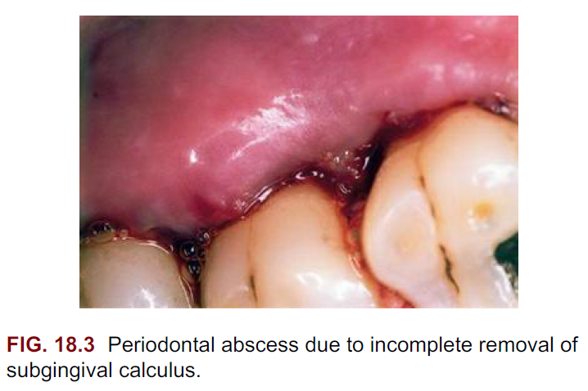

Slide 31
Nonperiodontitis Related Abscess
Impaction of foreign bodies, such as a toothbrush bristle, a piece of dental floss, orthodontic elastic, a dislodged cemental tear, food (such as fish bone) into the gingival tissue, and so on can result in abscess formation.
Periodontal abscesses caused by foreign bodies, related with oral hygiene aids, have been named “oral hygiene abscesses.”

Slide 32
Lateral perforation of the root during endodontic therapy and trauma to the tooth.

Slide 33
Local factors affecting morphology of roots such as cemental tears, external root resorption, invaginated tooth, and cracked tooth may predispose to periodontal abscess formation.

Slide 34
Pathogenesis
The entry of bacteria into the soft tissue pocket wall
Inflammatory cells are then attracted by chemotactic factors released by the bacteria,
the concomitant inflammatory reaction leads to
destruction of the connective tissues,
the encapsulation of the bacterial infection, and the production of PUS

Slide 35
Histopathology
Histologically intact neutrophils are found surrounding a central area of soft tissue debris and destroyed leukocytes.
At a later stage, a pyogenic membrane composed of macrophages and neutrophils is organized.

Slide 36
An acute inflammatory reaction surrounds the purulent area, and the overlying epithelium exhibits intracellular and extracellular edema and invasion of leukocytes.
Gram-negative bacteria may be seen invading the pocket epithelium and the altered connective tissue.

Slide 37
Diagnosis
The diagnosis of the periodontal abscess requires correlation of the history, and clinical and radiographic findings.
The dental history can provide information about previous periodontal treatments, endodontic therapy, and previous abscesses.

Slide 38
The suspected area should be carefully probed.
Continuity of the lesion with the gingival margin serves as the clinical evidence that the abscess is periodontal.
Other findings are ovoid swelling of the gingiva, pain, tooth mobility, tooth elevation, suppuration, either spontaneous or on digital pressure, and the presence of deep periodontal pockets.

Slide 39
Radiographically, it appears as a discrete area of radiolucency along the lateral aspect of the root.
However, lesions in the soft tissue wall of a periodontal pocket are less likely to produce radiographic changes than those deep in the supporting tissues.
Similarly, abscesses on the facial or lingual surfaces are obscured by the radiopacity of the root

Slide 40
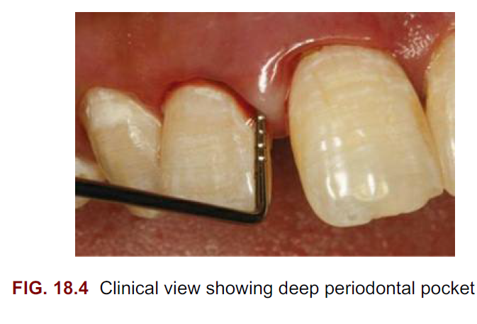

Slide 41
Differential diagnosis
Differentiation Between Gingival and Periodontal Abscess
Differentiation Between Periapical and Periodontal Abscess

Slide 42
Summary
Periodontal abscesses are a common and painful dental emergency resulting from bacterial accumulation or foreign body impaction in periodontal pockets. They affect both patients with or without active periodontal disease and require prompt management acute and long-term management

Slide 43
REFERENCES
Newman MG, Takei HH, Klokkevold PR, Carranza FA. Carranza’s clinical periodontology, 10th ed. Saunders Elsevier; 2007.
Lindhe J, Lang NP and Karring T. Clinical Periodontology and Implant Dentistry. 6th ed. Oxford (UK): Blackwell Publishing Ltd.; 2015.
Newman MG, Takei HH, Klokkevold PR, Carranza FA. Carranza’s clinical periodontology, 13th ed. Saunders Elsevier; 2018.

Slide 44
THANK YOU

